Slide 1
SRS Resident Information System BD
Prepared by : Md Yasin Arif
Supervised by : Rajaul Islam
Technology : Spring Boot, Maven, Spring MVC, Spring Security,Thaymlef, Hibernate,Spring JPA & MySql

Slide 2
Requirements
To Collect information to the residence Government want to launch web application for this purpose we think to build a web application to collect the residence (House Owner, Tenant) information. It is very easy to use any one can first registration as a user and he/she select his/her type and then login the web application and give his/her all required information. Police can see the list of the residence.

Slide 3
Requirements analysis
Create User
Registration User
Get House Owner Information
Get Tenant Information
User can view his/her Profile
User can Update his/her Information
Police can see the List of Resident

Slide 4
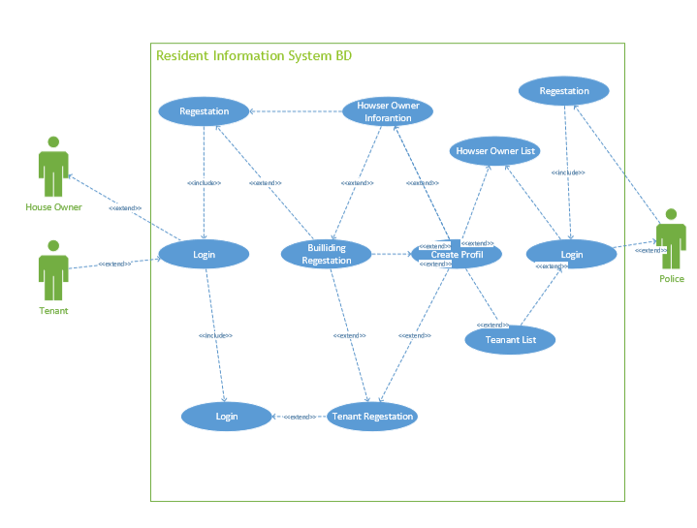
Use Case

Slide 5
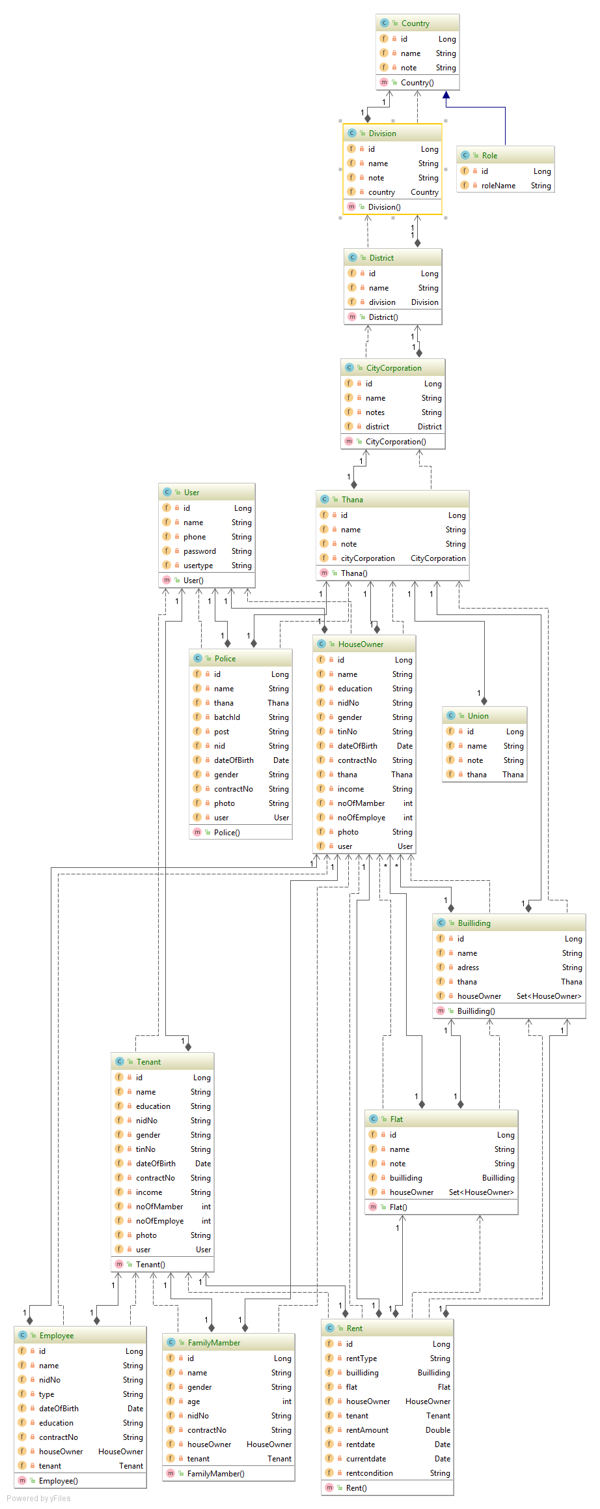
Class Diagram

Slide 6
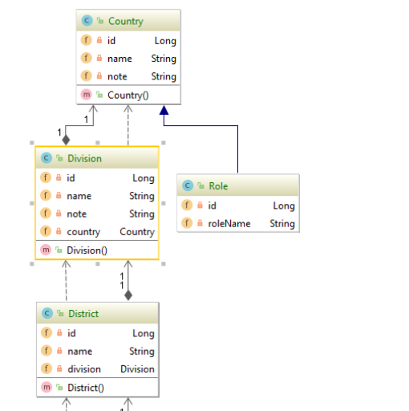
Class Diagram

Slide 7
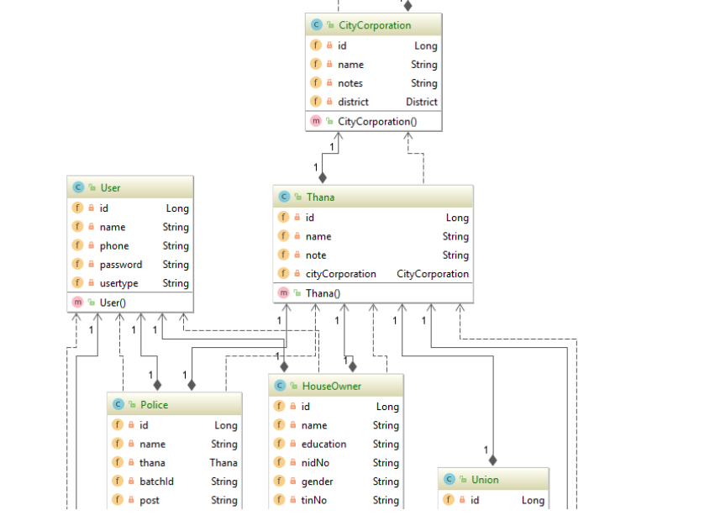
Class Diagram

Slide 8
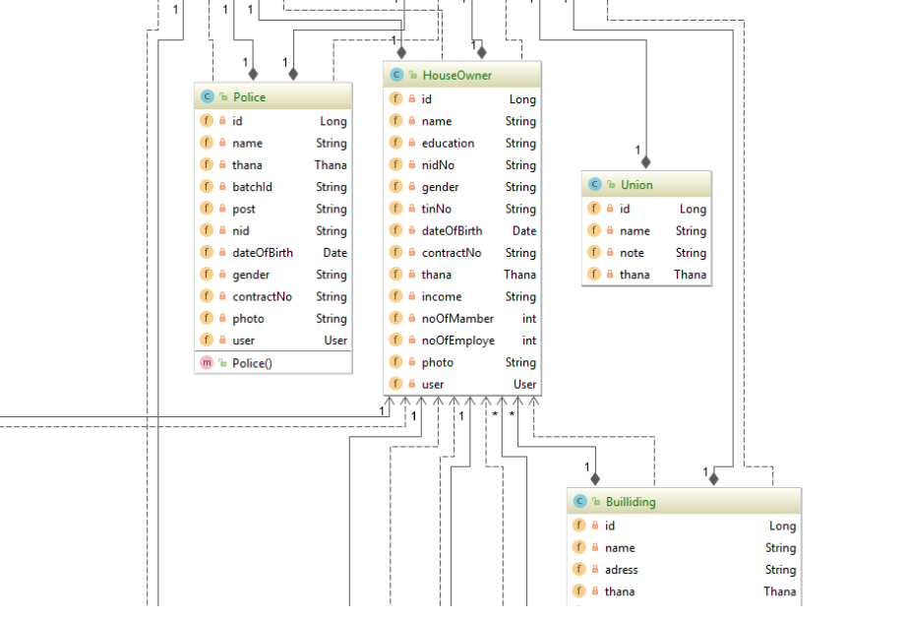
Class Diagram

Slide 9
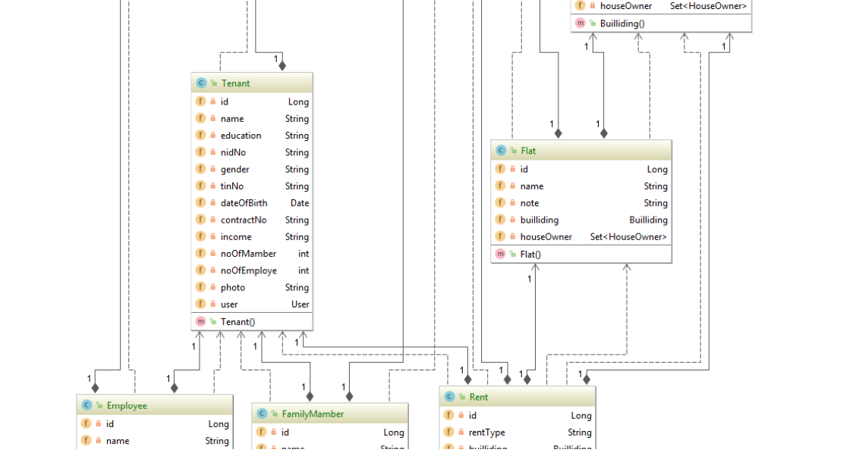
Class Diagram

Slide 10
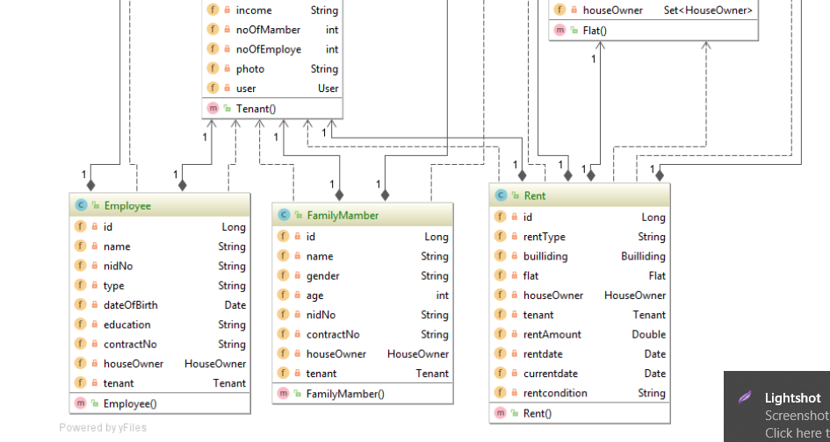
Class Diagram

Slide 11
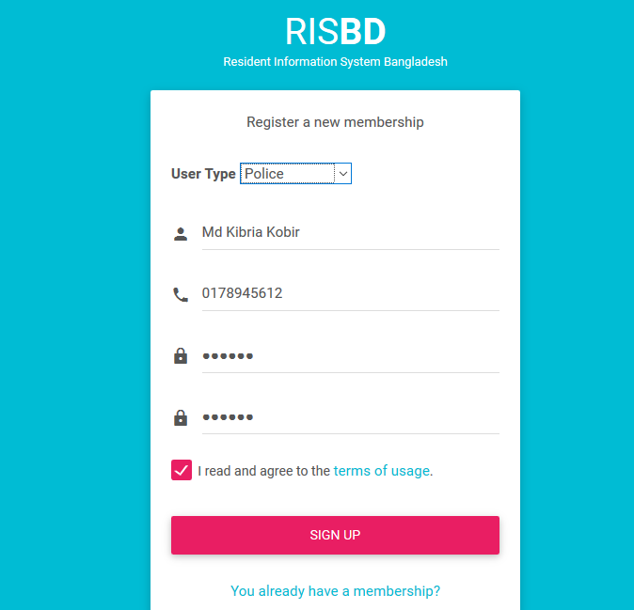
Sign Up Police

Slide 12
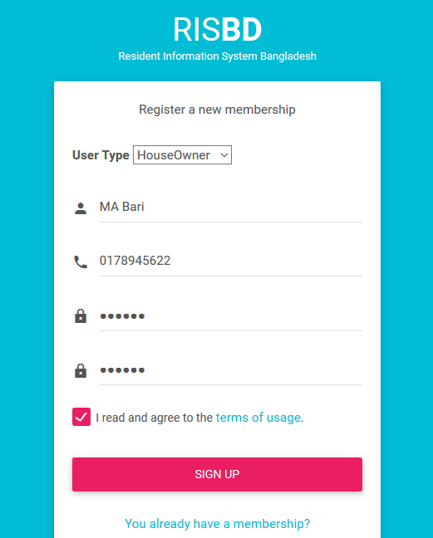
Sign Up House Owner

Slide 13
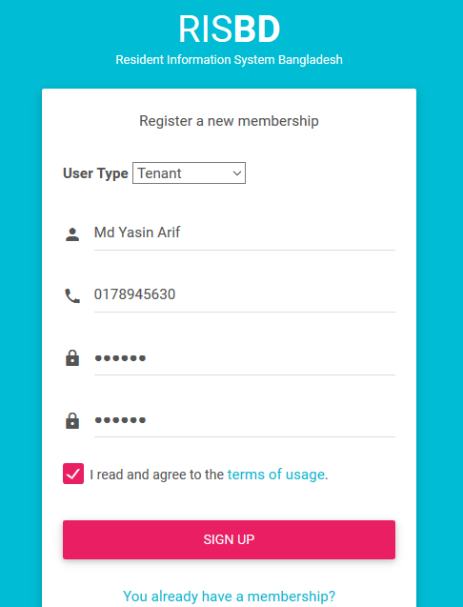
Sign Up Tenant

Slide 14
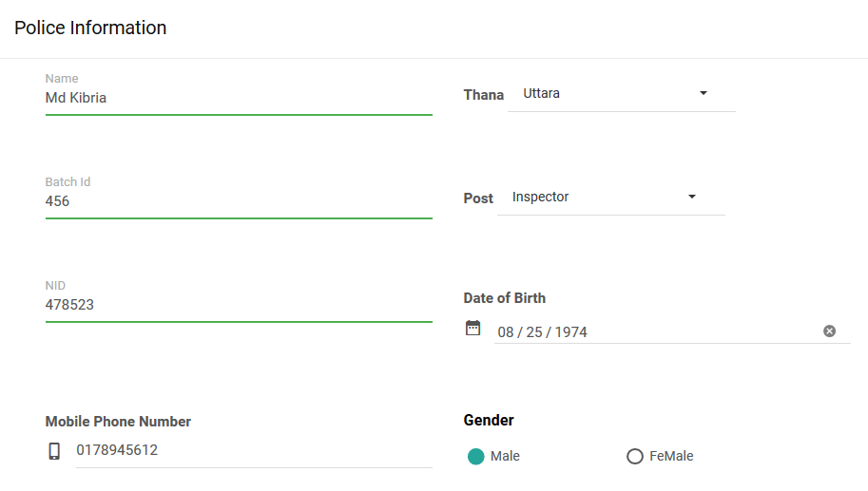
Police Registration From

Slide 15
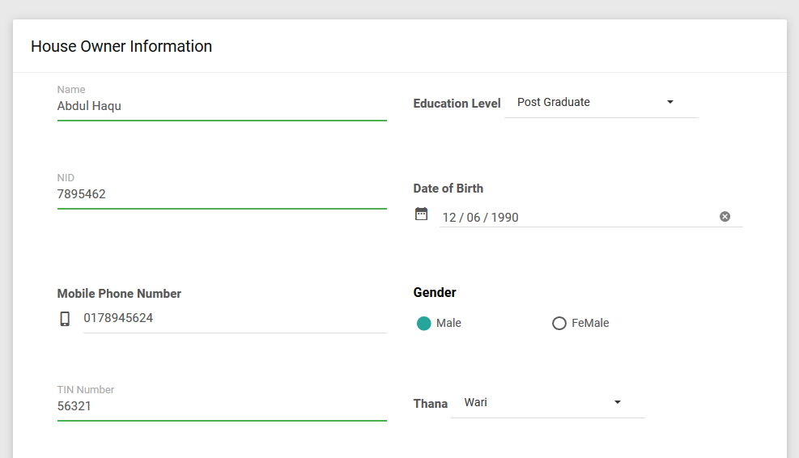
House Owner Registration From

Slide 16
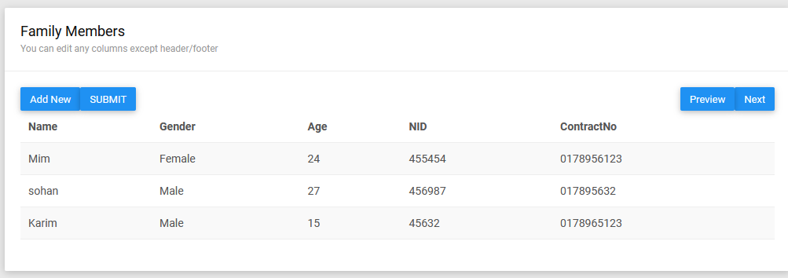
Family Members Registration From

Slide 17
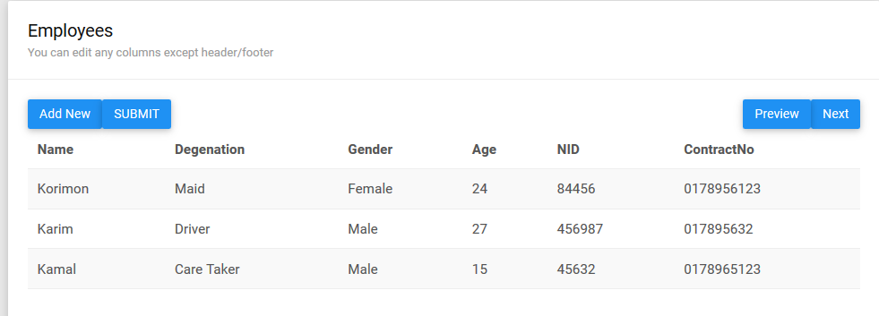
Employees Registration From

Slide 18
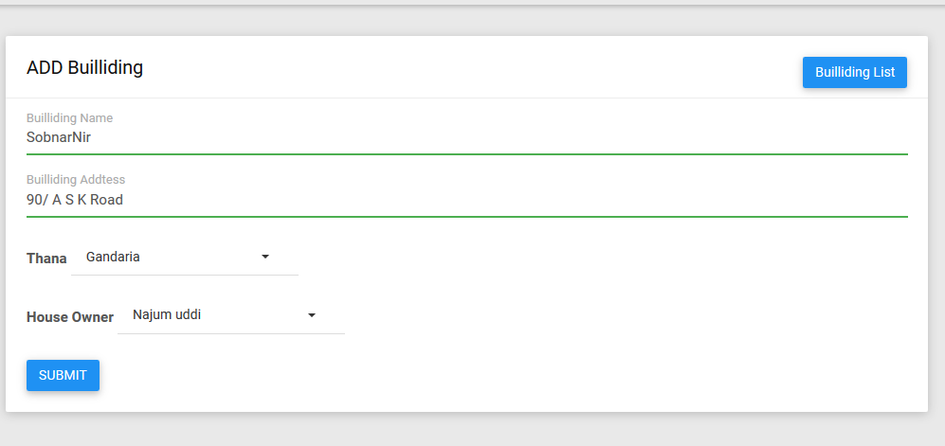
Building Registration From

Slide 19
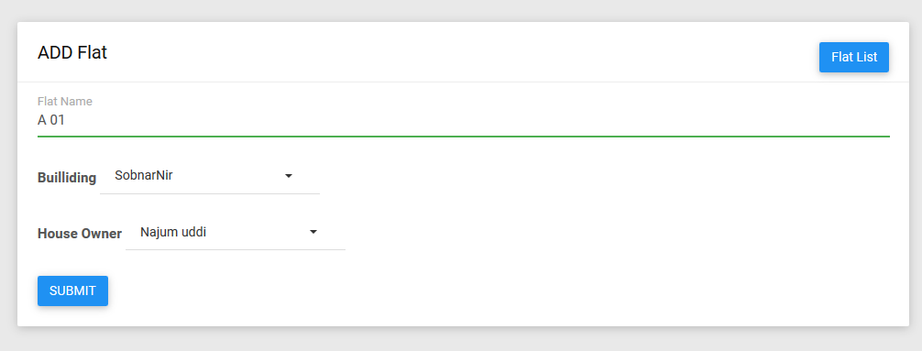
Flat Registration From

Slide 20
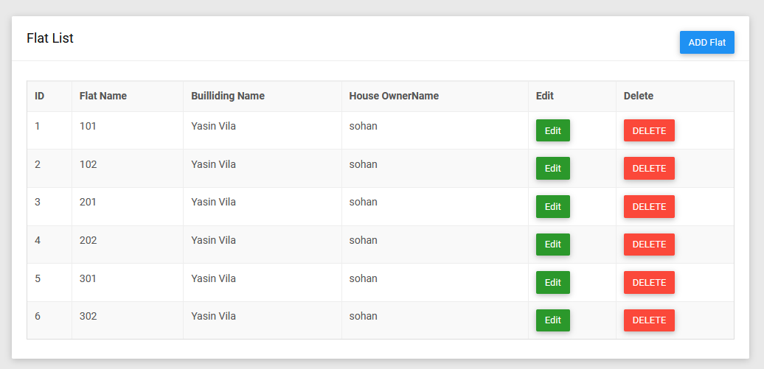
Flat List

Slide 21
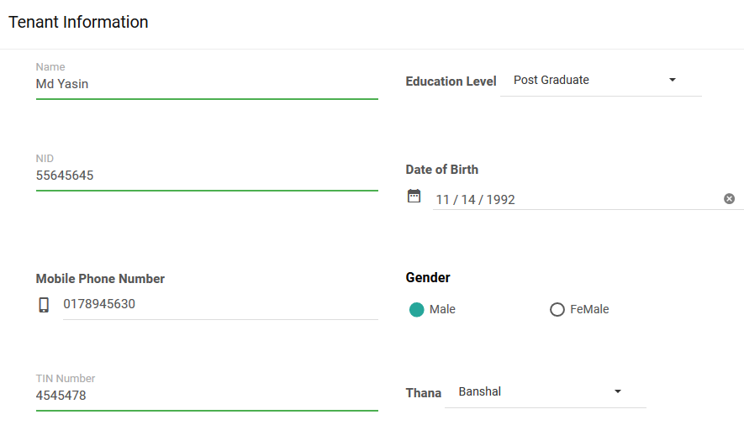
Tenant Registration From

Slide 22
Family Members Registration From

Slide 23
Employees Registration From

Slide 24
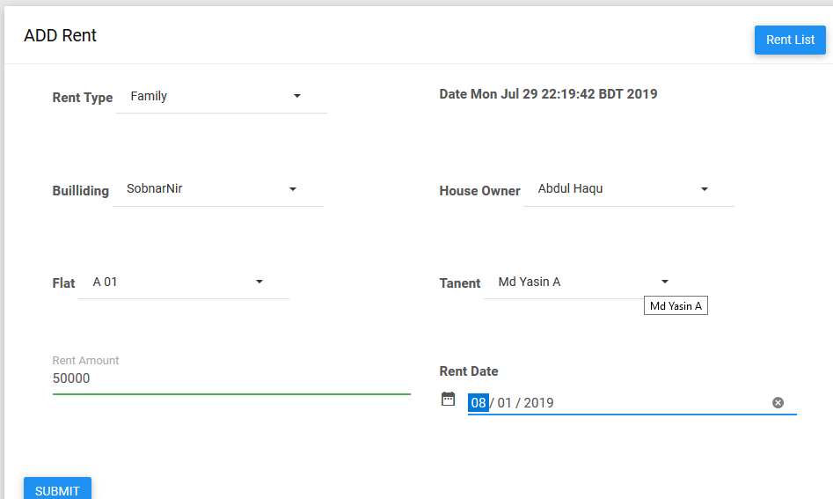
Rent From

Slide 25
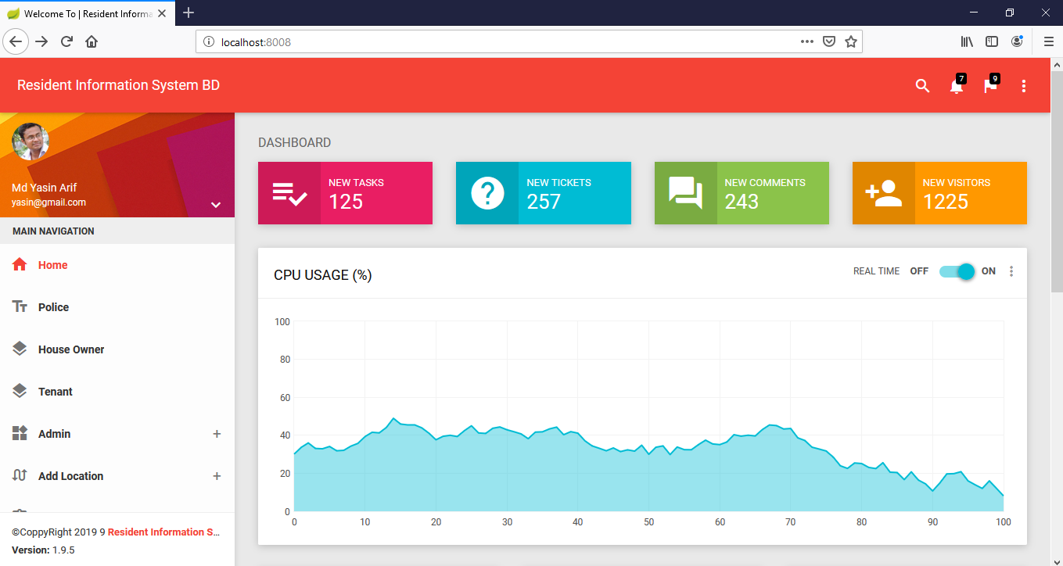
Home Page

Slide 26
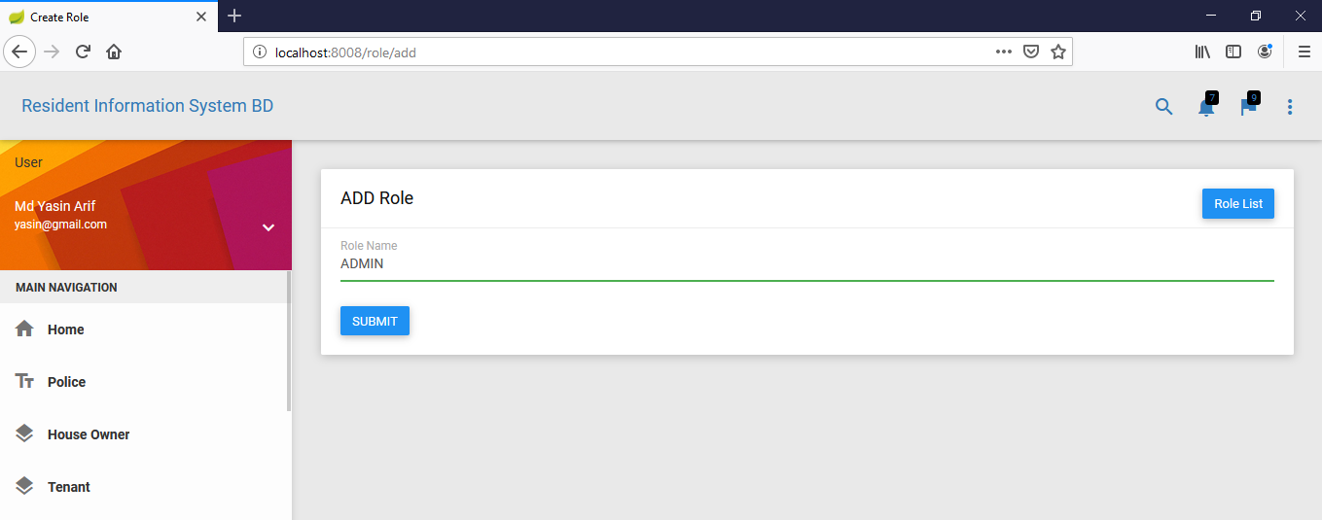
Add Role

Slide 27
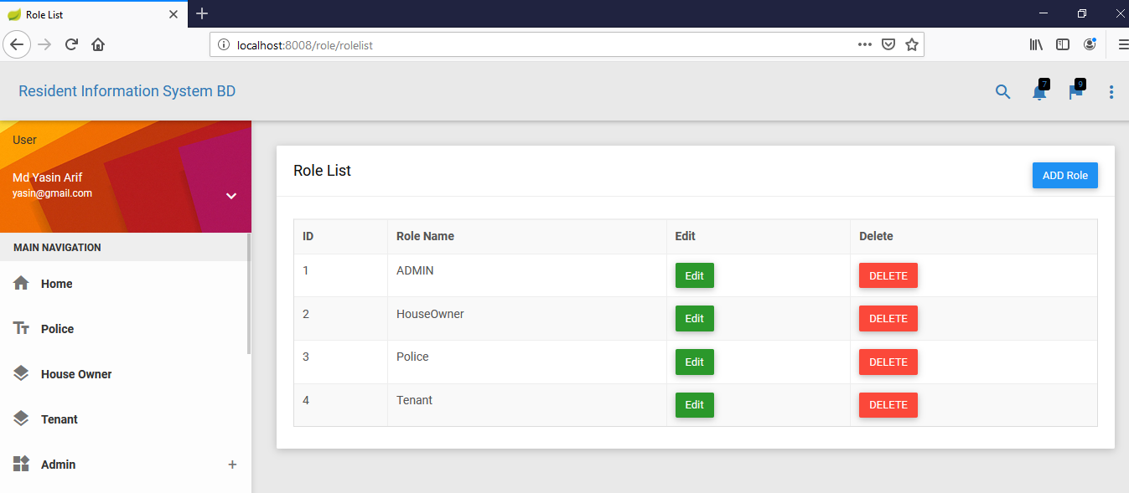
Role List

Slide 28
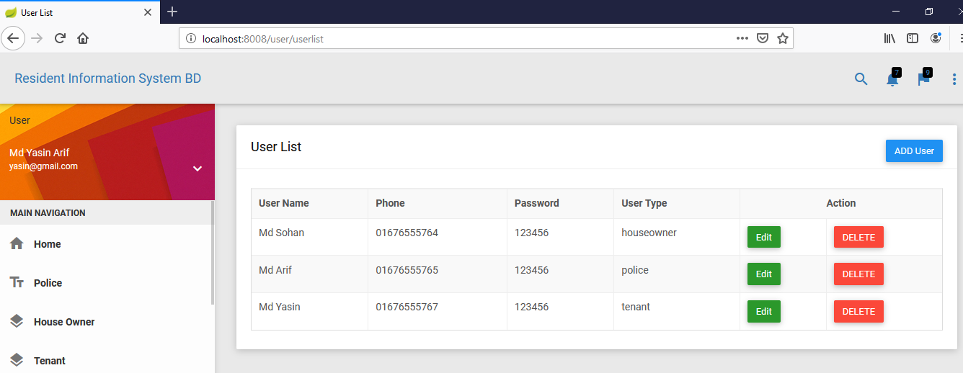
User List

Slide 29
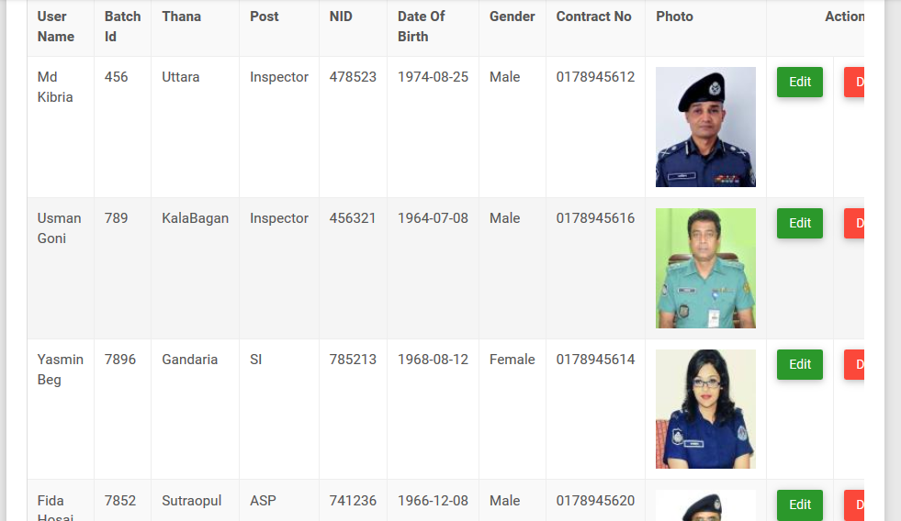
Police list

Slide 30
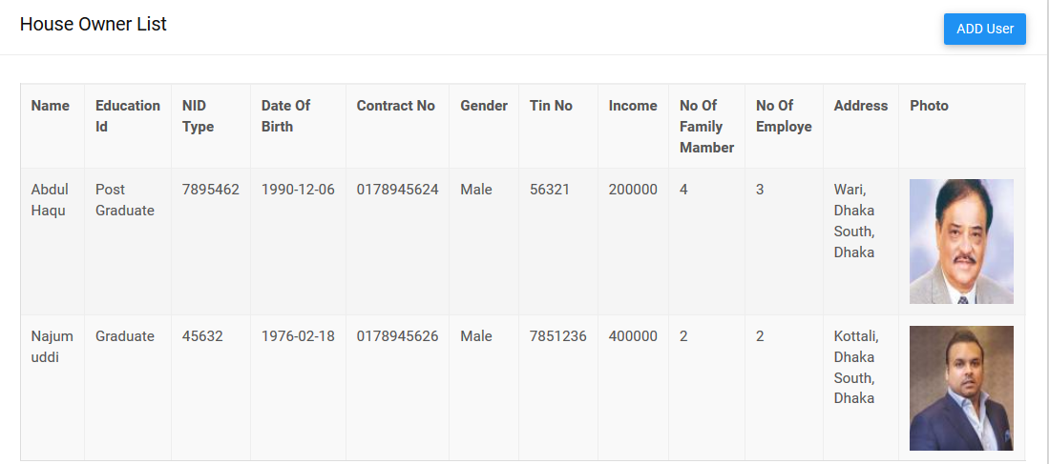
House Owner list

Slide 31
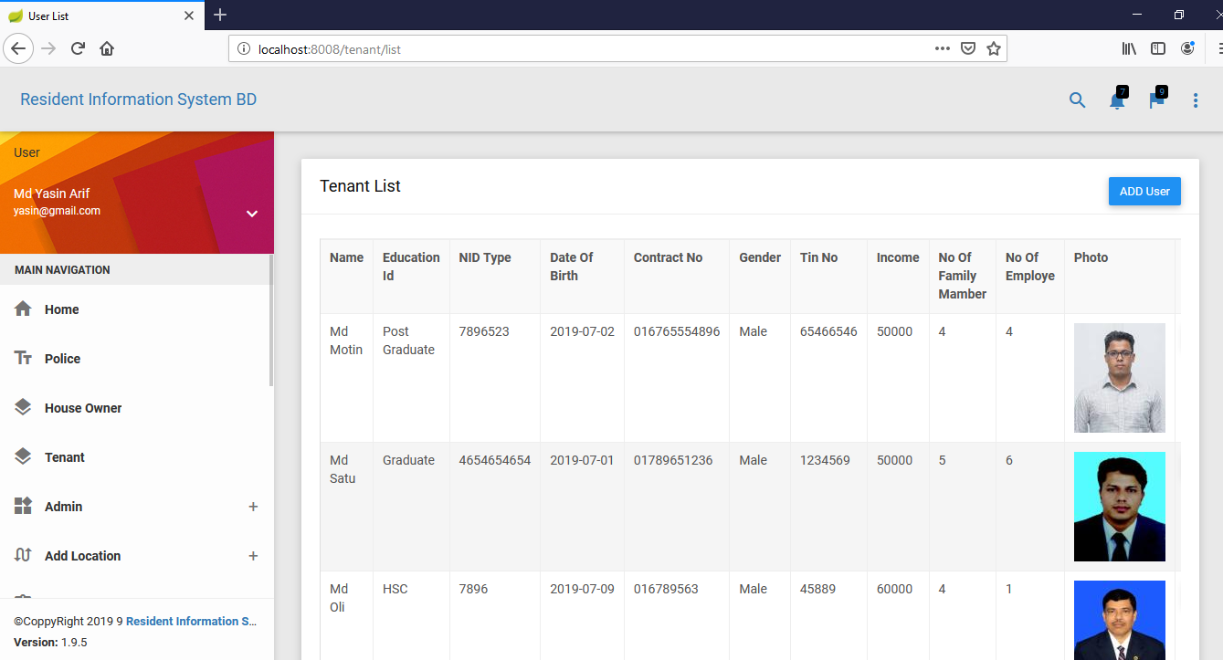
Tenant List

Slide 32
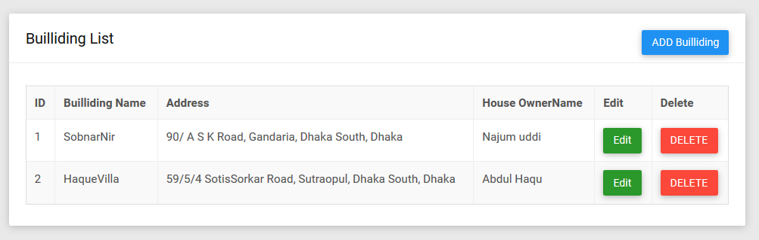
Building List

Slide 33
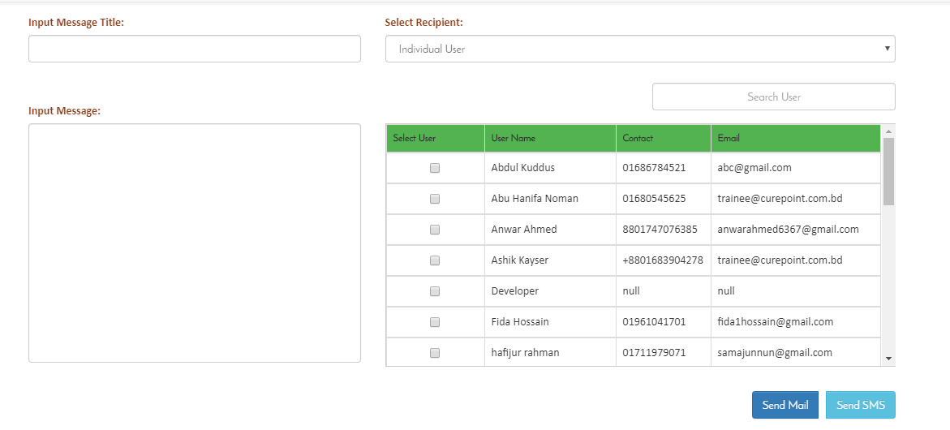
Notice Sent

Slide 34
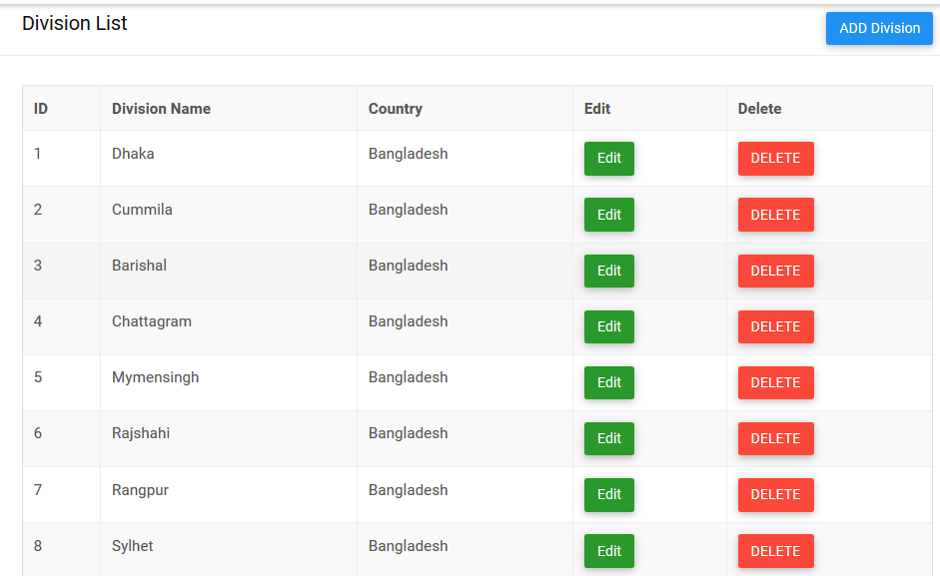
Division List

Slide 35
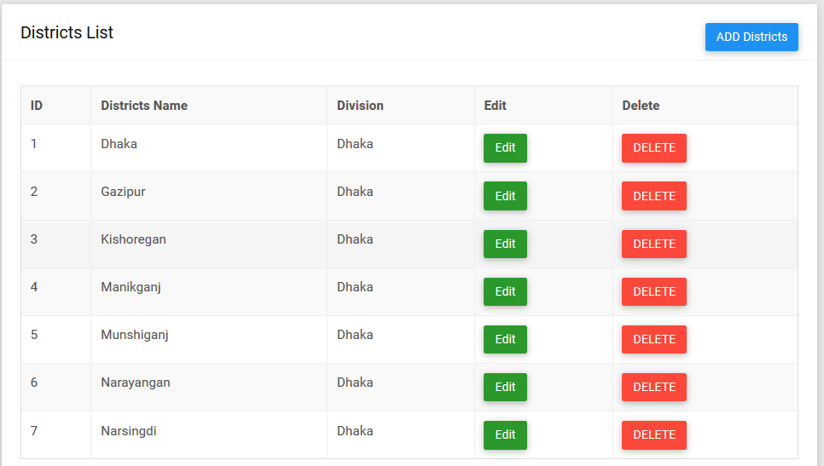
Districts List

Slide 36
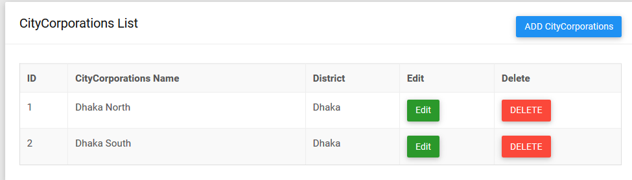
City Corporations List

Slide 37
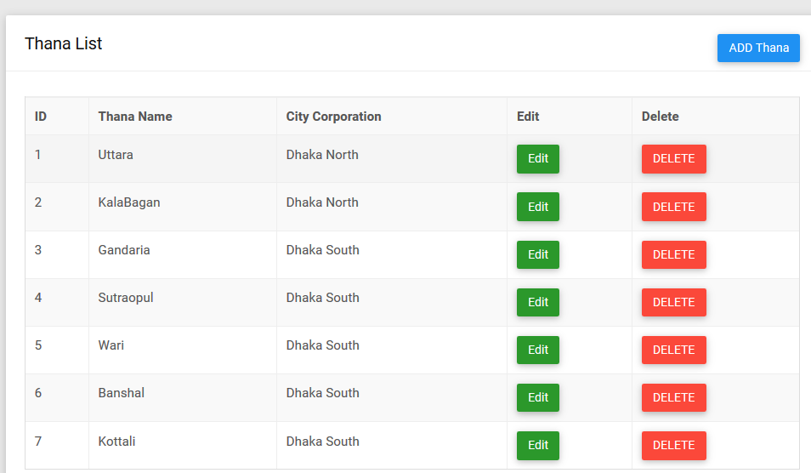
Than List

Slide 38
Thank You

